Slide 1
FAITH Alive!
Taste of Faith Sharing
January 31, 2023

Slide 2
Welcome and Introductions
Faith sharing team:
Deacon Mike Fletcher
Kelly and John Hamilton
Barb and Gene Schaefer
Gerri Riedel
Joe Deloy
Henry (Hank) Nieto
Joe Dunn
Gabby Erwin
Mary Engle and Mary Erwin (Synod liaisons)

Slide 3
Opening Prayer – Gerri Riedel

Slide 4
Synod Background – Mary Engle and Mary Erwin

Slide 5
Why are you here?
We’d like to hear your thoughts and expectations…

Slide 6
Faith Sharing Materials/Program
Formed Opening the Word is offered because:
COTM has invested in it to provide to the Parishioners.
The format is time-tested and available/free to us.
A process is in place to deliver materials to your email weekly.
Groups can decide to follow other programs (Formed offers many).

Slide 7
Faith Sharing Session Summary – John Hamilton
Gather: 10 – 15 minutes
Opening prayer: 2 minutes
Readings and Gospel: 5 – 10 minutes
Reflection: 2 minutes
Video: 5 – 10 minutes
Discussion: Up to 30 minutes
Business (next session location and assignments): 5 minutes
Closing prayer: 2 minutes

Slide 8
Suggested Ground Rules for Groups
Decide days/times, location, frequency
Start/end on time
Engage all members in discussions
Confidentiality
OK to agree/disagree
See handout
Remote (e.g. ZOOM) etiquette:
Quiet properly lit spot; Use the mute button; Remember you’re on camera!; Avoid mullti-tasking

Slide 9
Prepare for Reflection after Gospel Reading
Find a centering word/phrase
Quiet your mind
No judgement

Slide 10
Gospel Reading – Joe Deloy

Slide 11
Reflection/Lectio Divina

Slide 12
Video
Formed website: formed.org – link will be provided
Must have TV and video connection available if viewing as a group
Recommended to view prior to meeting

Slide 13
Discussion questions – Kelly Hamilton
St. Louis University questions will be provided weekly
Main focus – how does the Gospel apply to you personally?

Slide 14
5 Pillars of Faith Sharing
Worship
Education
Fellowship
Service
Group Maintenance

Slide 15
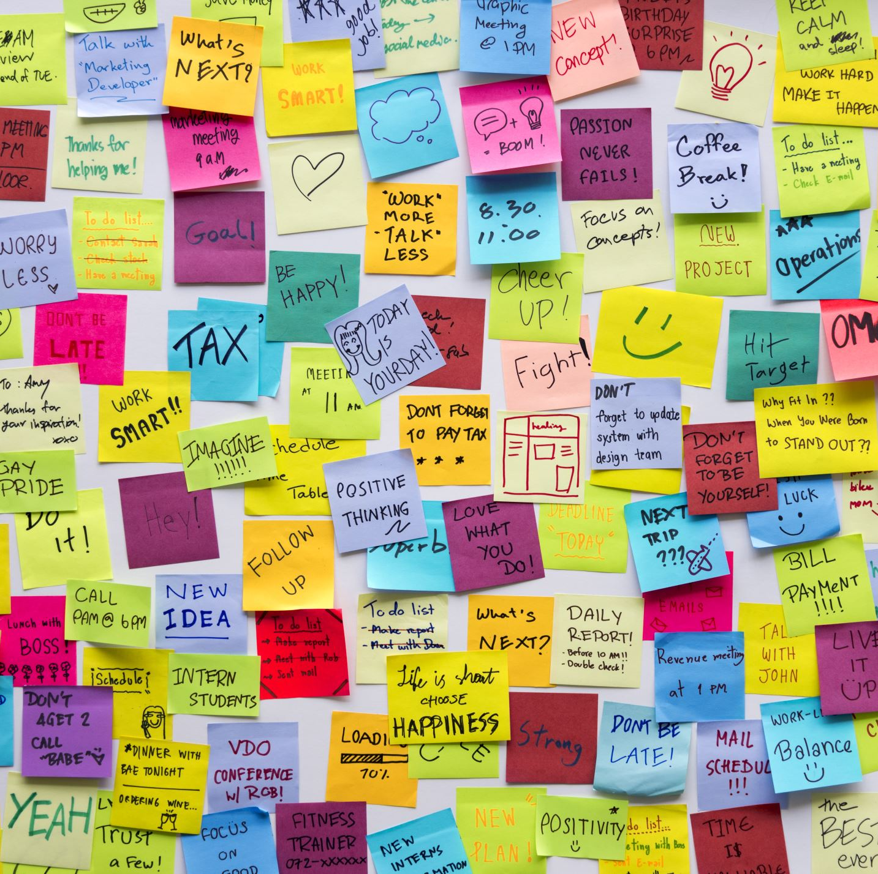
Resources for your groups
FAITH Alive! page on COTM website. Look under resources.
Formed website.
St. Louis University. Note that updates for current year have been suspended.
Opening the Word Videos and Leader and Participant guides - click the “Show More” button several times to reveal guides.

Slide 16
Next Steps
Complete FAITH Alive! interest cards:
Can indicate who you’d like to be paired with.
Please tell us if you’d like to be a leader.
FAITH Alive! Team will match people with similarities and/or specific pairing requests.
Mid-way meeting – middle of March
Identify leaders
Starter Kit for leaders
Group formation (up to 12 people each)
Groups meet!

Slide 17
Next Steps Calendar

Slide 18
Other Faith Sharing Programs
Chosen Season 2 has been suggested:
Contact Chad Reno if interested.
See sign-up in back.

Slide 19
Q&A

Slide 20
Closing Prayer – Joe Deloy

